Slide 1

Field Training Experiences and Chemical Compatibility
Virtual Inception Workshop STDF - Asia Pesticide Residue Mitigation through the Promotion of Biopesticides and Enhancement of Trade Opportunities
6-7 August 2020
NGAN CHAI KEONG, Ph.D.
Principal Research Officer
Soil Science, Water and Fertiliser Research Centre
Malaysian Agricultural Research and Development Institute (MARDI)
www.mardi.gov.my

Slide 2
Outline of Presentation
Field training experiences
Chemical compatibility

Slide 3
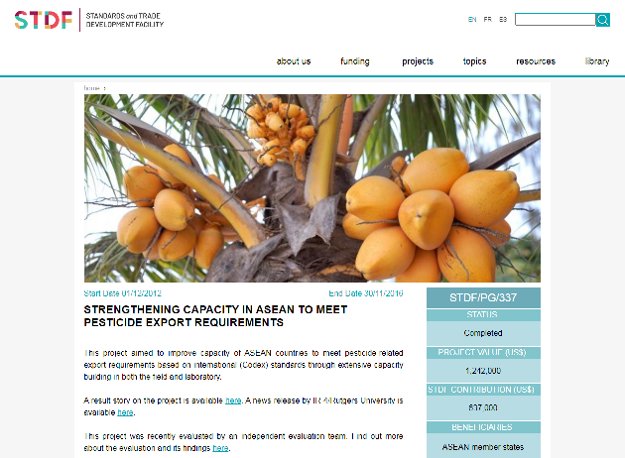
Field training experiences

Slide 4










THE FIRST PROJECT (2013-2016)
Sponsor: STDF
(Standards and Trade Development Facility)
USDA-FAS & IR-4 (Project & technical co-ordinator)
ASEAN Secretariat & ASEAN Expert Working Group –MRL
study # PR10990
pyripoxyfen-mango: 6 field trials
Study # PR11251
pyripoxyfen-papaya: 7 field trials
MARDI, Malaysia
(6 field trials)
Brunei (one field trial)
The Philippines
(3 field trials & lab analysis)
SFA, Singapore
(Lab analysis: 1st, 2nd & 3rd field trial)
DOA, Malaysia
(Lab analysis: 4th, 5th & 6th field trial)
Malaysia (3 field trials & lab analysis inclusive of Brunei’s samples)

Slide 5
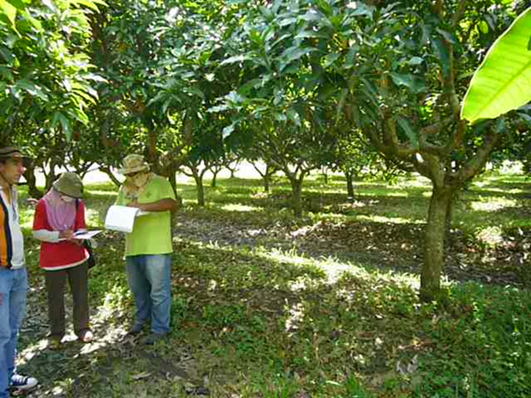
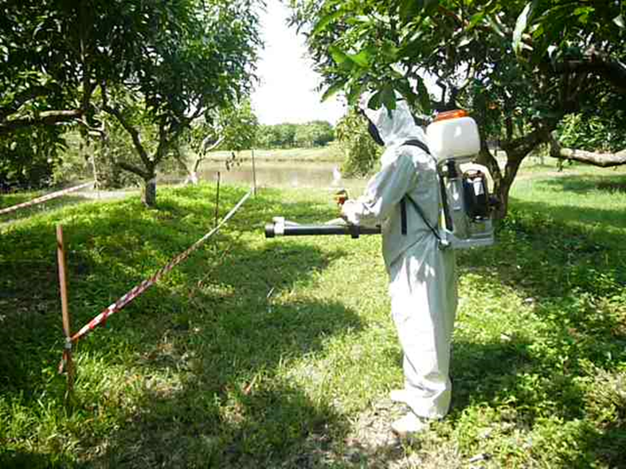

INTRODUCTION
Hands-on field training with Dr. Braverman in 2012.
Field training for project members and invited observers (ASEAN countries) was conducted in Thailand, January 2013.
Hands-on field training

Slide 6
Training experiences
Field measurement and recording.
Calibration of discharge rate of spraying equipment.
Calibration of sprayer walking speed.
Pesticide application.
Sampling protocol.
Shipment of samples to local laboratory and Singapore.
Quality assurance of the field phase of supervised residue trials.

Slide 7
Benefits
Exposure to conducting supervised residue field trial according to Good Laboratory Practice standard.
  Recording of field measurement, data and information.
Networking and continuous collaboration with international partners.

Slide 8
Pesticide compatibility
Solution mixtures of pesticide products are to be applied on selected crops followed by crop samplings (multi-residue decline studies).
Compatibility test for selected pesticides before multi-residue decline studies begin.

Slide 9
Country where studies would be conducted | Crop / Target pests | Chemical Pesticides Currently used causing residue issue | Group of pesticides for compatibility test
Indonesia Malaysia Sri Lanka Thailand | Chili pepper / Thrips, Aphids & Whitefly | abamectin acephate acetamiprid amitraz chlorpyrifos diazinon fipronil imidacloprid methomyl profenophos | Group 1
Bangladesh Nepal | Greens / Aphids, Whitefly, Grasshopper & Diamondback moth | acetamiprid imidacloprid malathion | Group 2
Cambodia Laos | Basil / Aphids & White fly | chlorpyrifos cypermethrin | Group 3 – no test
Vietnam | Dragon fruit / Bipolaris Anthracnose | metalaxyl hexaconazole propiconazole | Group 4
Cambodia | Rice / Panicle blast | tricyclazole | Group 5 – no test

Slide 10
Procedure on pesticide compatibility test
1. Wear gloves , mask , goggles and whatever safety equipment is listed on the labels.
2. Get 2 clean containers that can hold over a liter, preferably one with a lid that you can close and shake.
3. Get a strainer that you can use to filter out any precipitate. Something like the photo below.
4. Put the test substances in order with all the EC formulations first , then SL, then SC formulation. Within each formulation type, create an order of the smallest volume to largest volume(Acetamiprid 0.25 ml/L... up to Malathion 2.5ml/L).
5. Pour 1 liter of water into one container.
6. Add 0.25 ml Acetamiprid to the water.
7. Shake well, observe the color, write it down and take a picture.
8. Add the second product to the same first liter of solution you started with.
9. Shake well, observe the color, write it down and take a picture.
10. Wait a few minutes and see if there is any odd color change, heat given off or any precipitate formed.
11. If the mixture is to cloudy or you can't tell if a precipitate has formed, pour from one container to the other container through the strainer.
12. Keep repeating the process with each new product you add,
13. If there is some type of adverse reaction (Lets say after adding product number 5), go back and prepare products 1-4. Skip 5 and add number 6 instead and keep going until you reach a problem.
14. If any are left out, prepare a second liter of water an combine only the ones that were left out. Hopefully, they will all get along ok.
15. After you have determined the maximum number that can all be within one liter mix we want to know if the mixture is phytotoxic.
16. Place the mixture in a sprayer and see if the mixture is spraying out ok without clogging.
17. Shake well and spray 4 separate areas (Replications) of areas (Maybe about 1 square meter/plot) with a dense population of small weeds. Observe sprayed plots at 3, 7 and 14 days after application for any leaf burn, stunting or odd appearance. Set up a control plot too. Record and photograph.
18. After spraying look at the nozzle and the bottom of the sprayer for any unusual amount of clumps/clogging.

Slide 11
Evaluating compatibility of pesticides
The following observations were made:
  Colour change in solution.
  Exothermic effect in solution.
  Precipitation in solution.
  Any filtered solids in the sieve.
  Phytotoxic effect of solution mixtures.

Slide 12
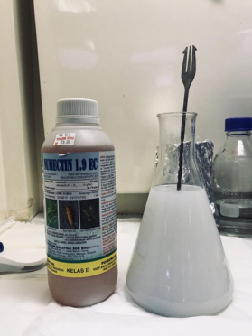
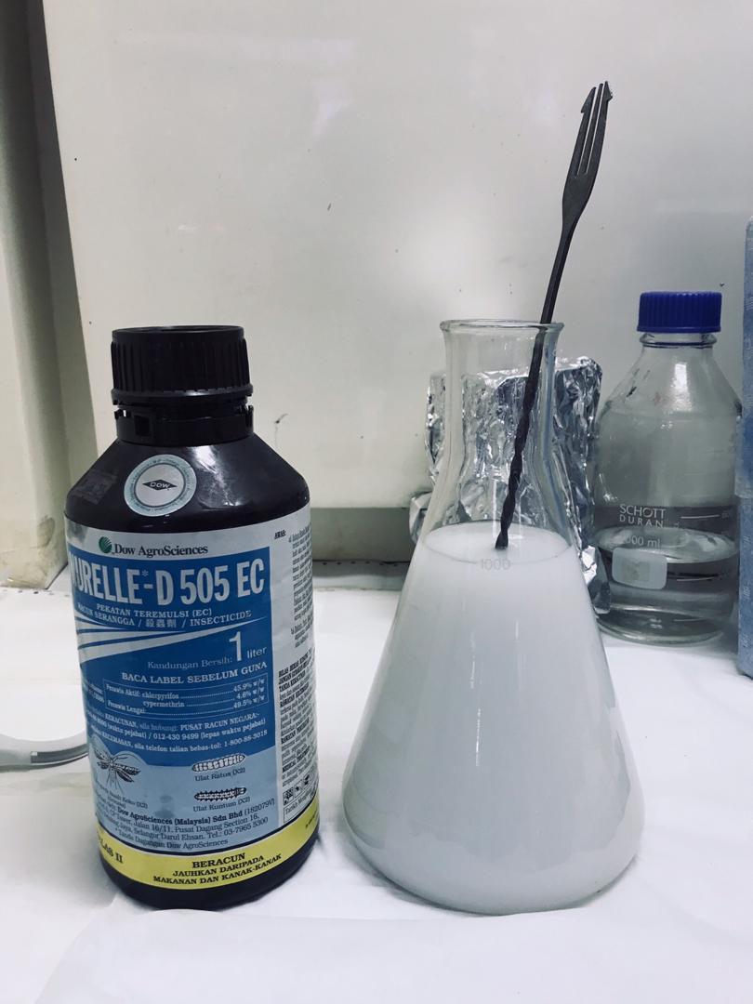
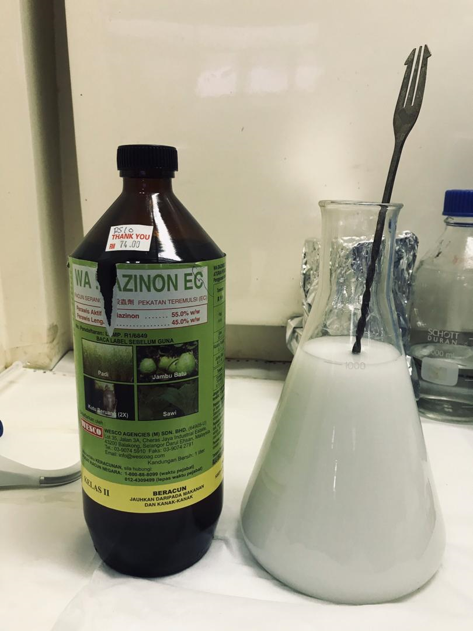
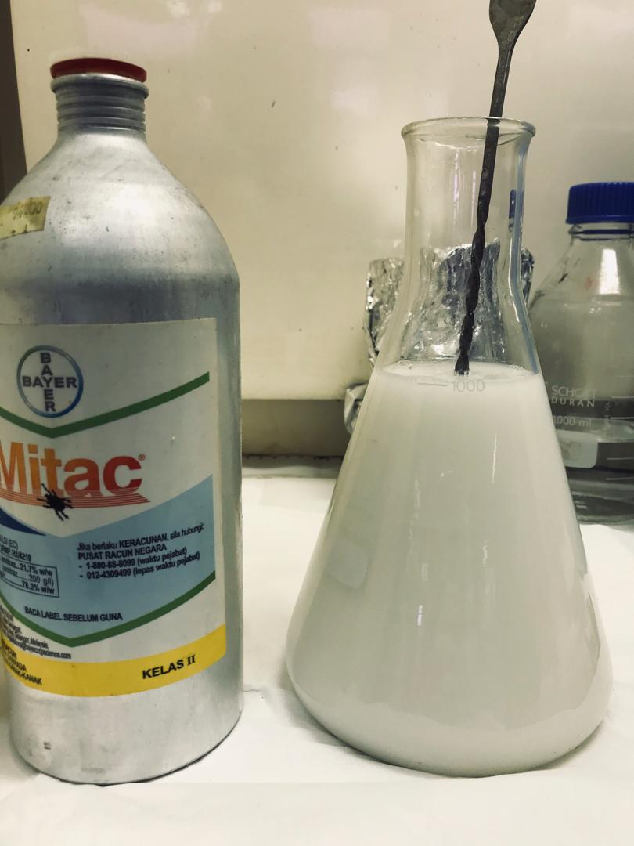

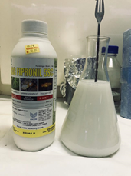
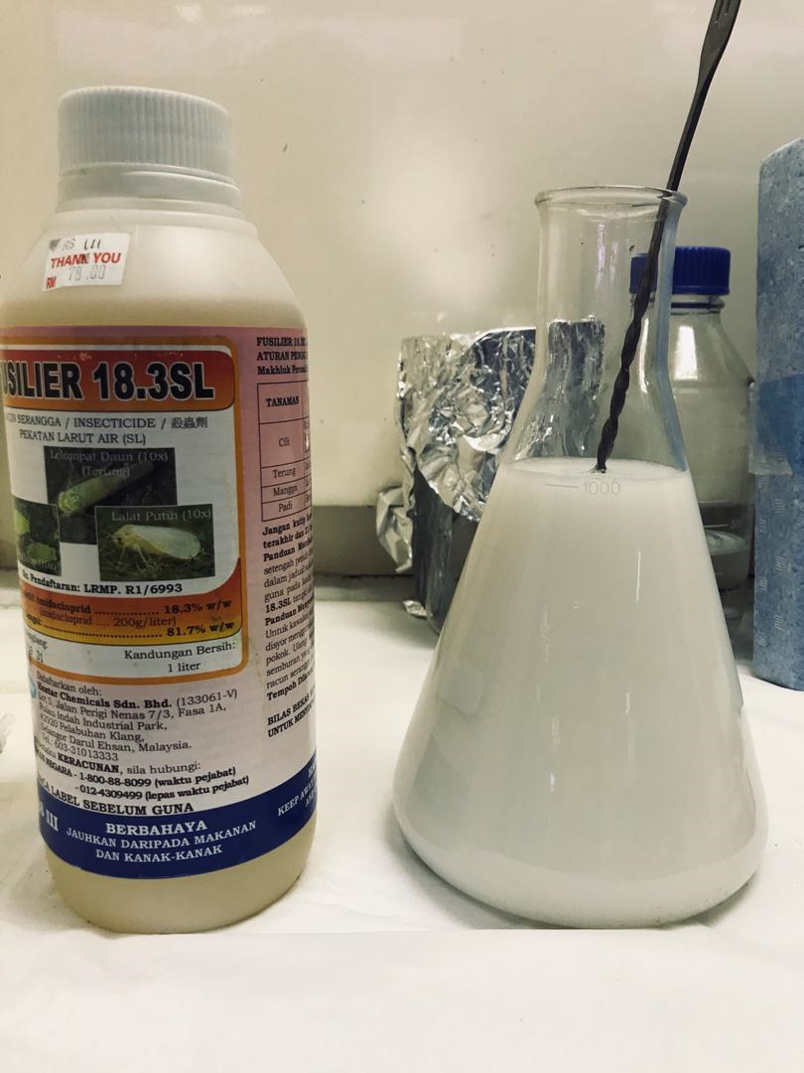
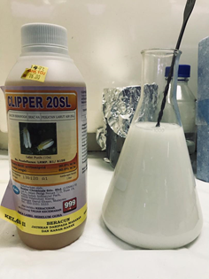
Pesticide compatibility - Group 1
Abamectin
Chlorpyrifos + cypermethrin
Diazinon
Amitraz
Fipronil
Imidacloprid
Acetamiprid

Slide 13
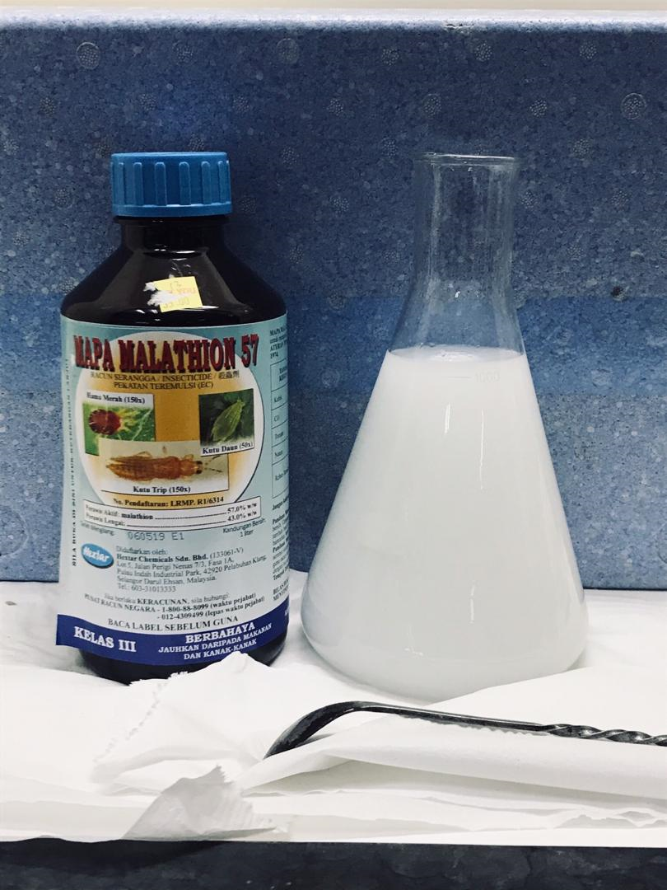
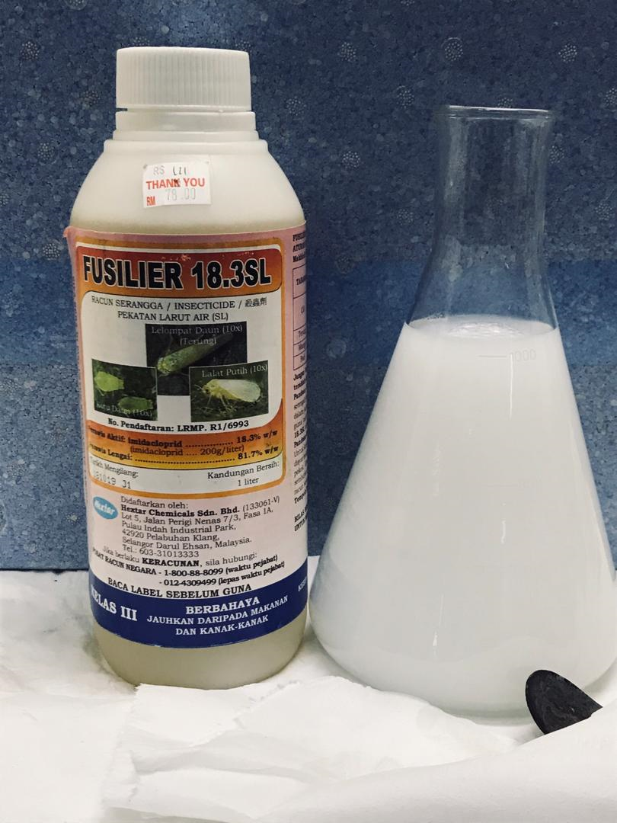
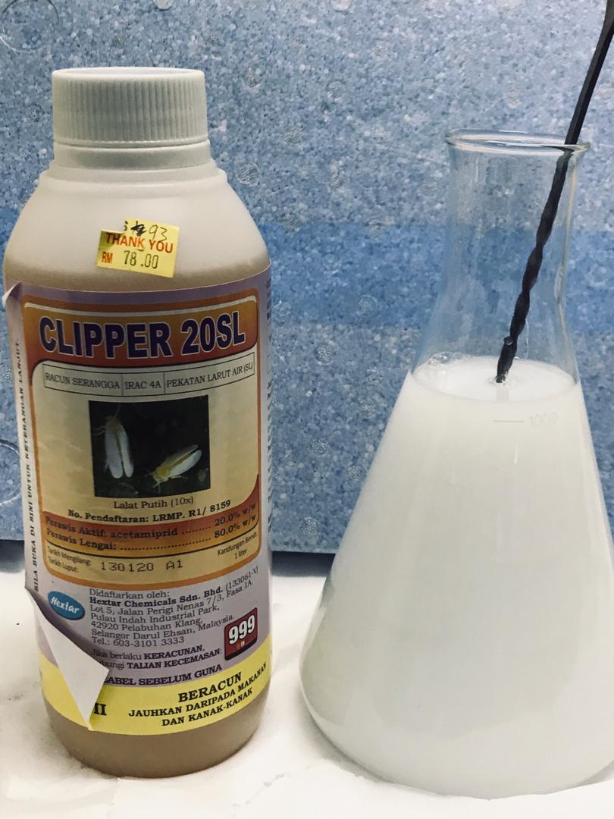
Pesticide compatibility - Group 2
Malathion
Imidacloprid
Acetamiprid

Slide 14
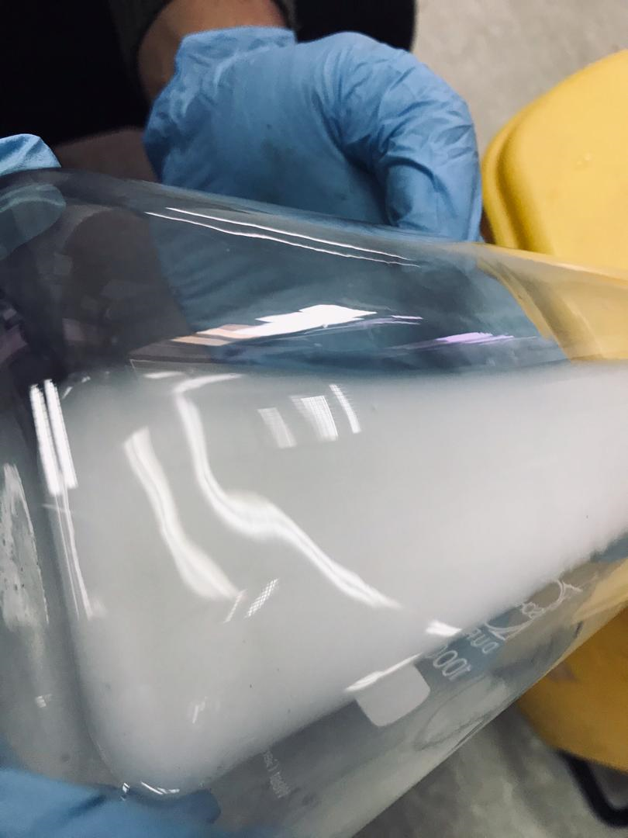
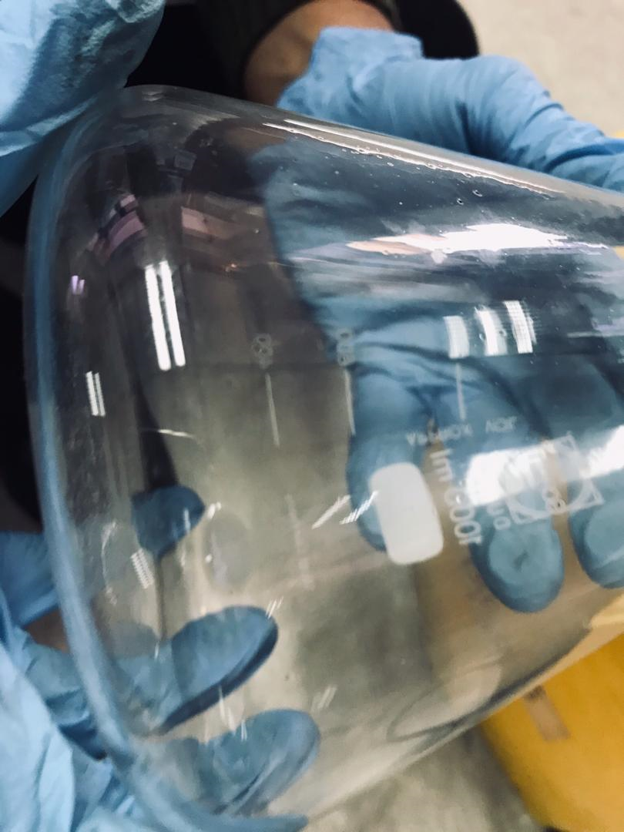
Pesticide compatibility - Group 2
No observed precipitation.

Slide 15
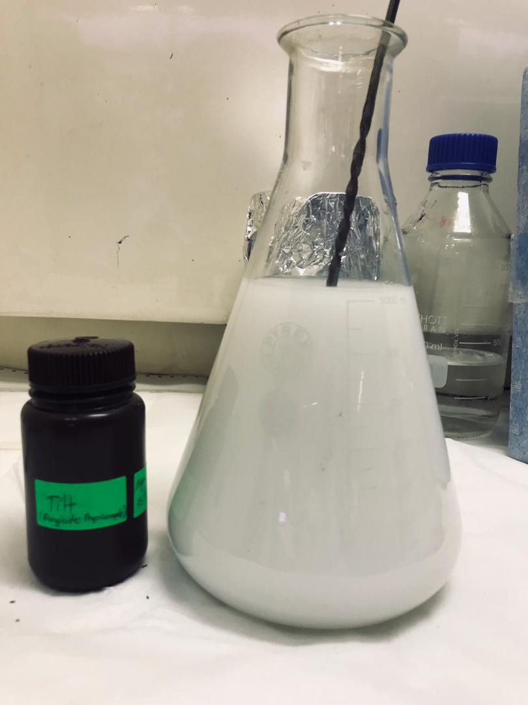
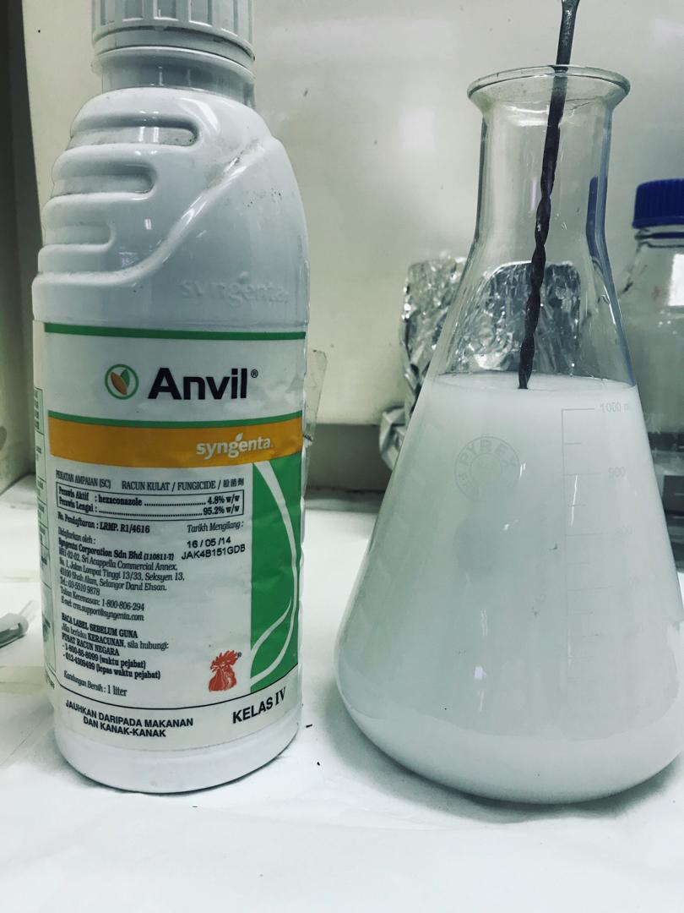
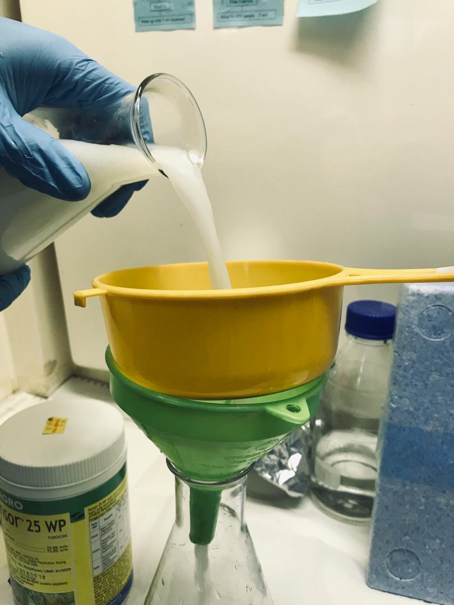
Pesticide compatibility - Group 4
Propiconazole
Hexaconazole
Metalaxyl

Slide 16
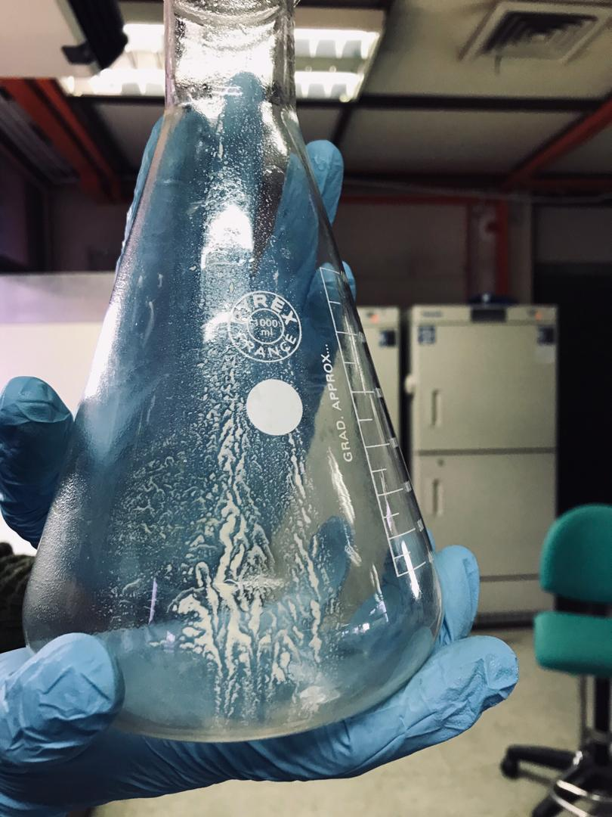
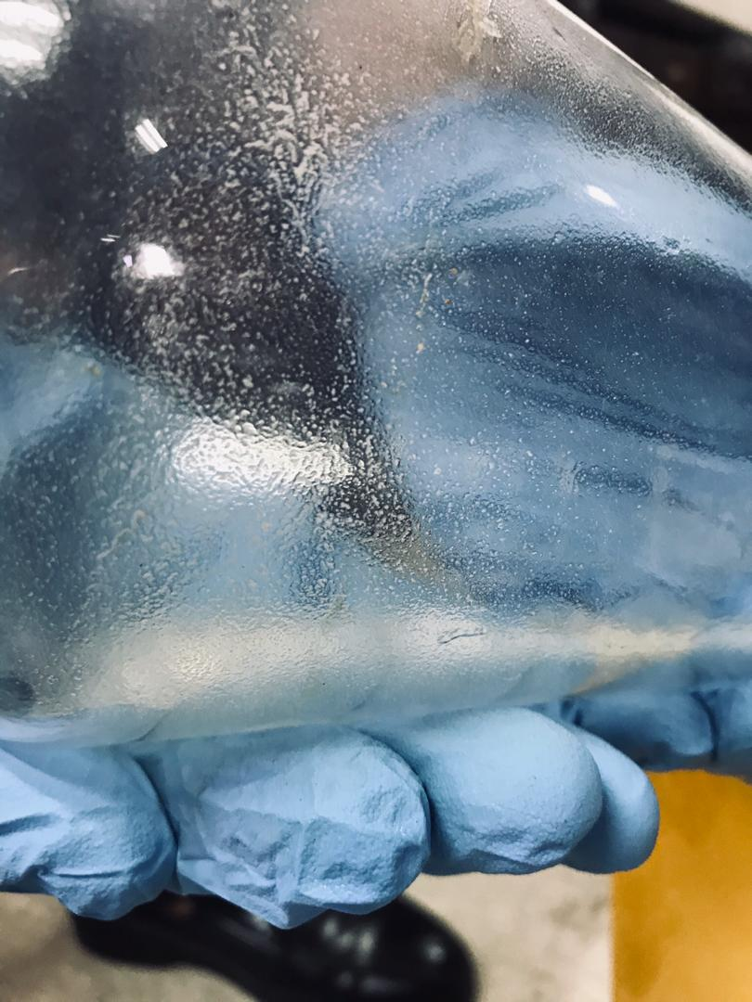
Pesticide compatibility - Group 4

Slide 17
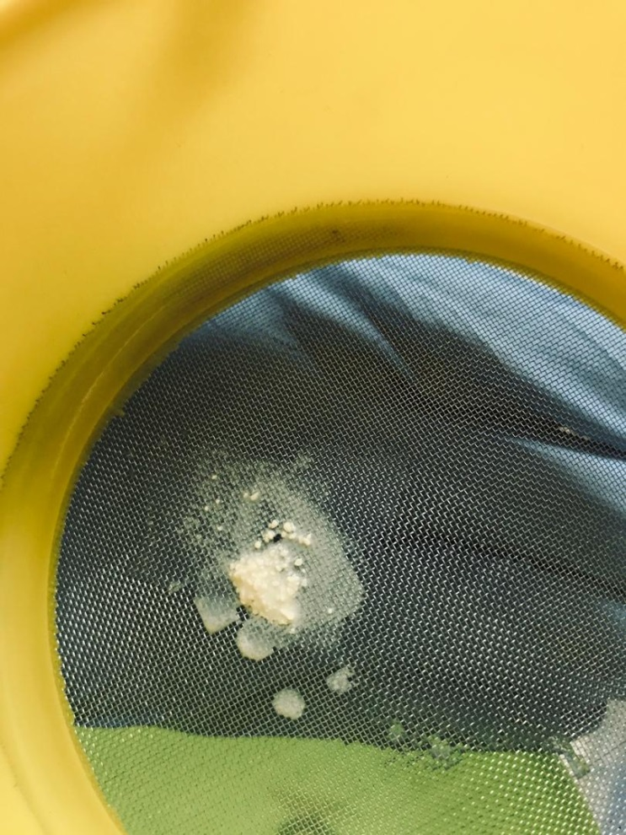
Pesticide compatibility - Group 4
Filtered solids on the sieve.

Slide 18
Results from pesticide product mixing test
The pesticides were compatible (no exothermic effect, precipitation & filtered solids) solid for group 1 and group 2.
For group 4, excluding metalaxyl (WP formulation), the rest of the pesticides (propiconazole & hexaconazole) were compatible.

Slide 19
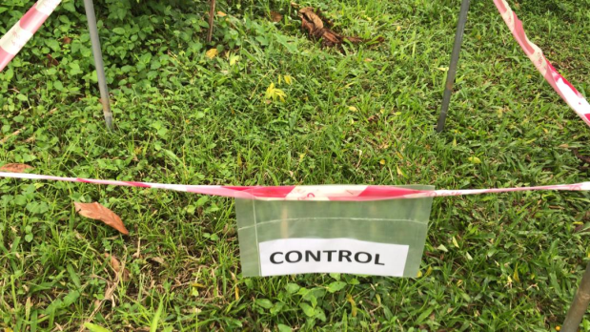
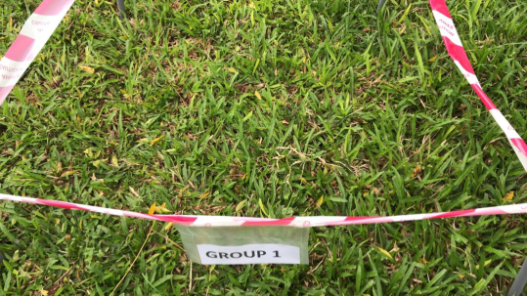
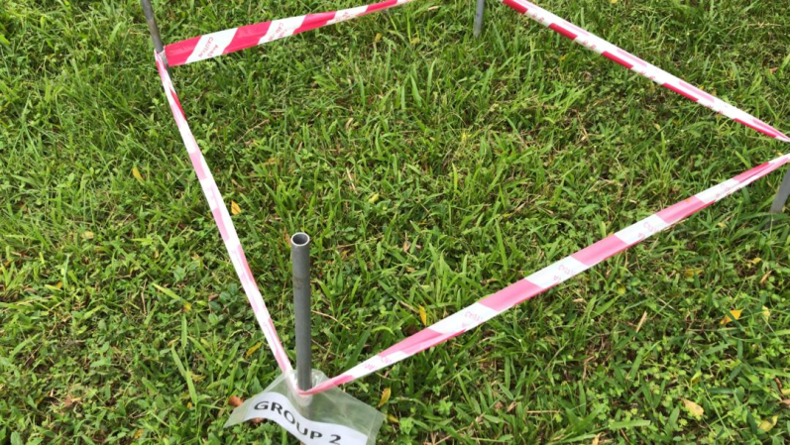
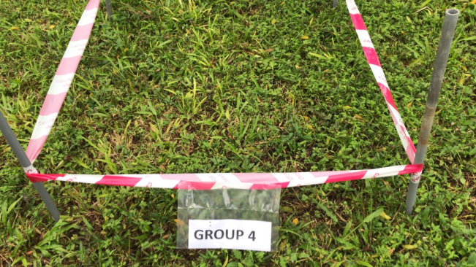
Phytotoxic effect observation at 3 days after application
Control
Group 1
Group 2
Group 4

Slide 20
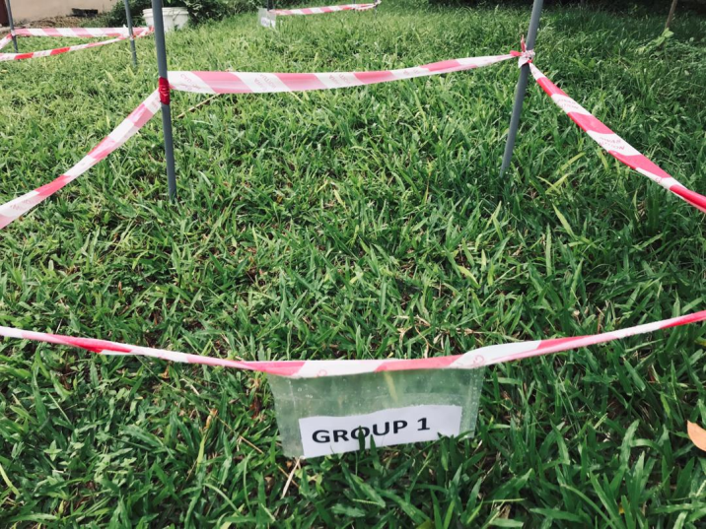
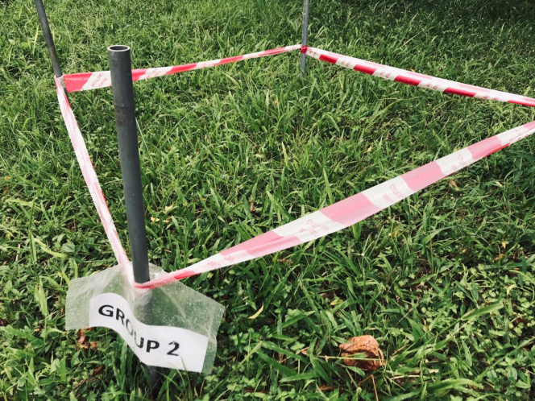
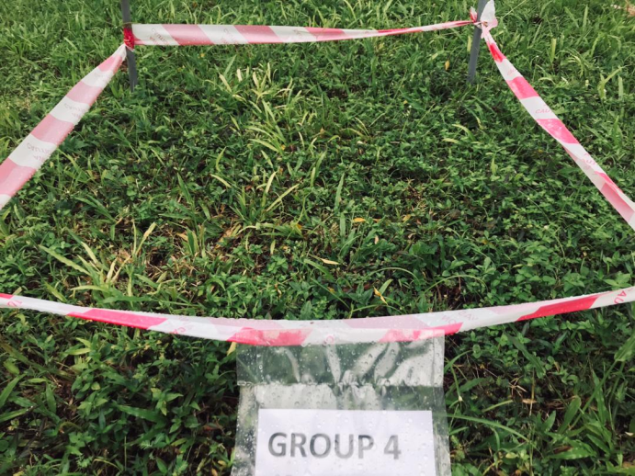
Phytotoxic effect observation at 7 days after application
Group 1
Group 2
Group 4

Slide 21
Progress of phytotoxic observation
No phytotoxic effect was observed up to 7 days after application in Group 1, Group 2 and Group 4 plots.
The last observation (14 days after application) is scheduled on 10 August 2020.

Slide 22


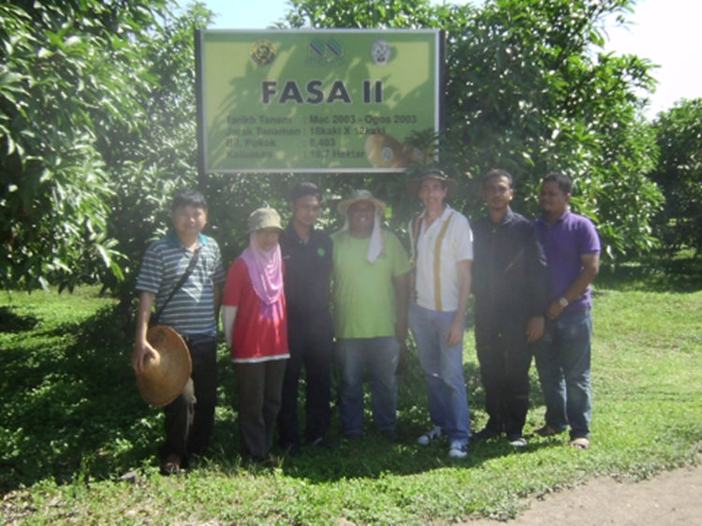


Acknowledgement
Dr. Braverman
Mr. Shahid
Mr. Azhar
Ms. Jamaliah

Slide 23
THANK YOU

